Slide 1
ESS Auto Framework Training – Getting Started
2011.12.07
Webber Ling, Shanghai

Slide 2
Agenda
Introduction
Framework Overview
Main features walk through
Q&A

Slide 3
Introduction

Slide 4
Introduction
High-level Conception
-> What is Testing Automation?
-> Purpose (Benefits & Risks)
-> Framework (What? Why? How? When? Who?)

Slide 5
Framework Overview

Slide 6
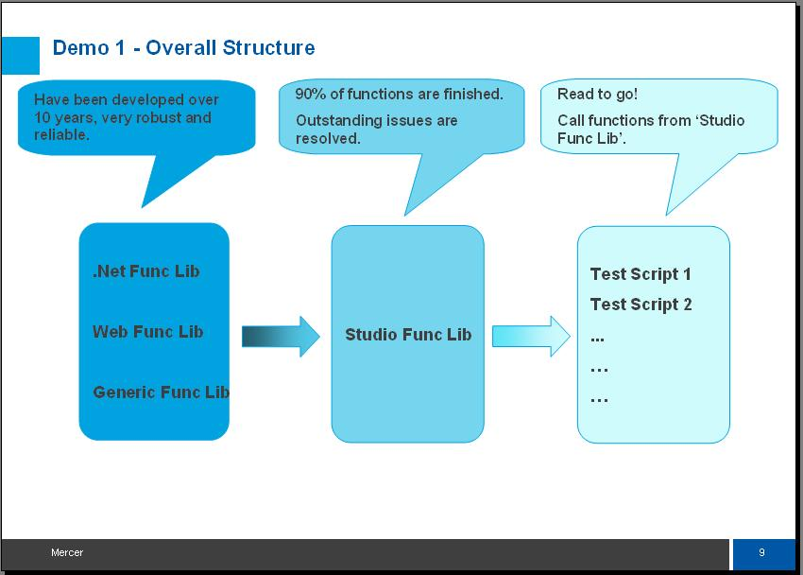
Framework Overview
\\cnshn13db04v\ESS_Automation_Framwork\Training\Documents\ESS QTP Automation Framework.doc

Slide 7
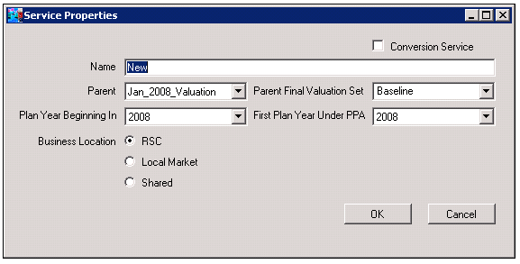
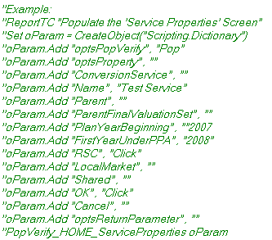
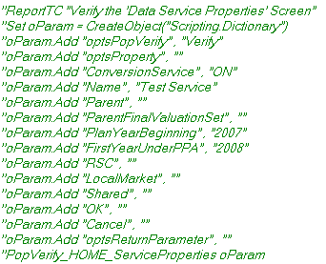
Framework Overview

Slide 8
Main Features Walkthrough

Slide 9
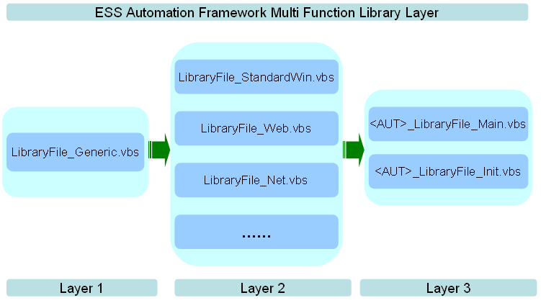
Main Features Walkthrough

Slide 10
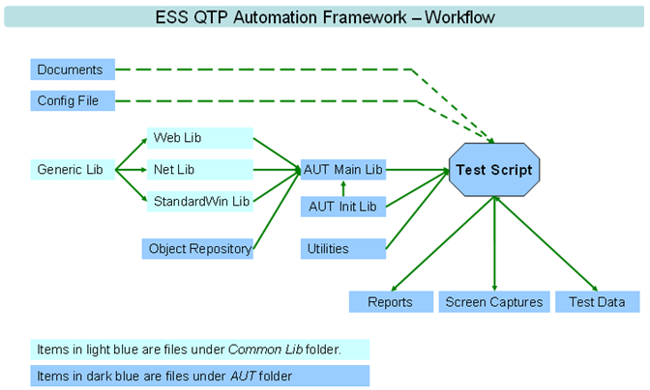
Main Features Walkthrough

Slide 11


Main Features Walkthrough

Slide 12
Q&A

Slide 13

www.mercer.com.au

